Slide 1
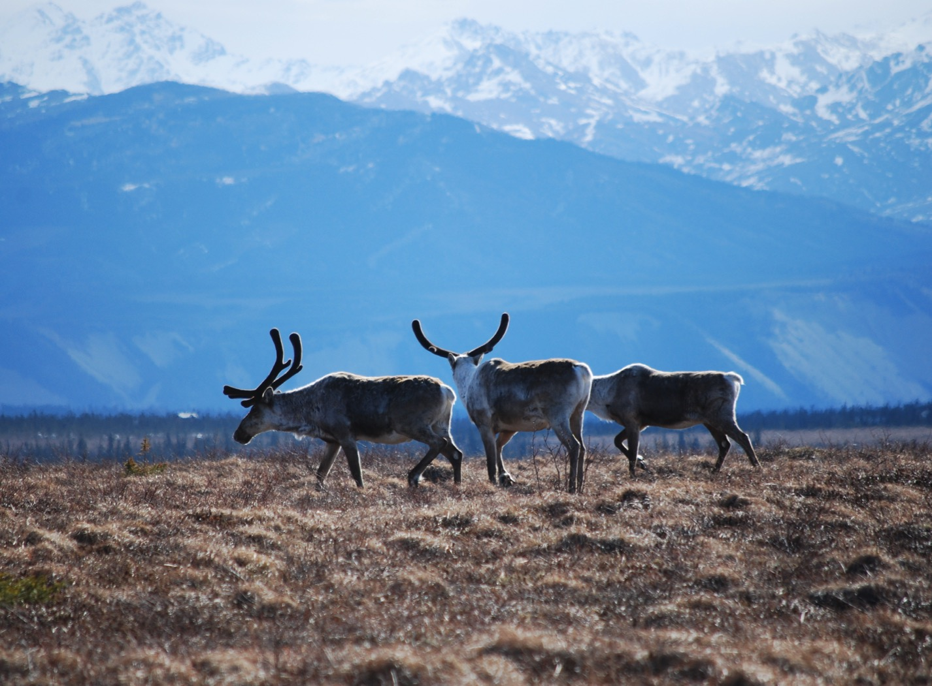
Arctic Boreal Vulnerability Experiment (ABoVE)
2018 ABoVE Airborne Flights
22 July 2018 (DOY 202)
AVIRIS-NG: Interior Alaska
Charles Miller, Deputy Science Lead
Jet Propulsion Laboratory, California Institute of Technology
and the ABoVE Science Team
For Hank Margolis, Eric Kasichke, Bruce Tagg
NASA HQ
2018

Slide 2

22 July 2017/DOY 202
Interior Alaska
Daily Status:
AVIRIS-NG / Dynamic Aviation B-200 (N53W)
REPORT DATE: 21 July 2018
Current Status of Aircraft: GREEN
Current Status of AVIRIS: GREEN
Current Deployment Location: Fairbanks AK (PAFA)
Crew: Heidt, Jones, Nolte, Rios
Science Planning: A Thorpe
Data Processing: W Olsen-Duvall
Instrument Managers: M Eastwood, I McCubbin
Instrument PI: R Green
Science Lead: C Miller

Slide 3
22 July 2017/DOY 202
Interior Alaska
Daily Summary:
Fairbanks – Healy – Delta Junction – 40-mile Herd/Yukon Charlie – Yukon Flats – Fairbanks
Clouds prevented acquisition of Line B85 in Yukon Charlie area
Needed to descend to 10,000 ft to remove condensation from nadir port window
Line B86 repeat acquisition over Big Trail Lake (Fairbanks)
Notes:
Fairbanks Daily News-Miner had a story in todays paper about the 40-mile Caribou Herd
http://www.newsminer.com/features/sundays/alaska_science_forum/parting-a-sea-of-fortymile-caribou/article_6450bcf4-8b92-11e8-a192-3f5d81f497af.html

Slide 4
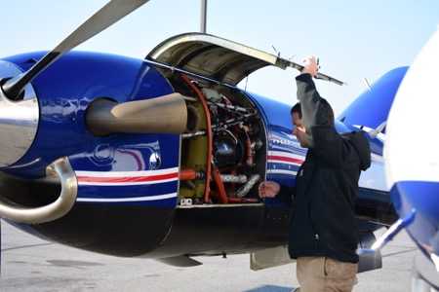
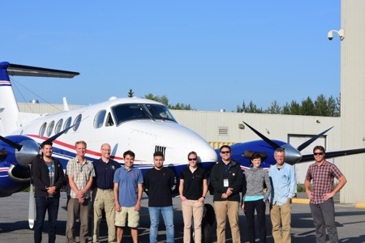
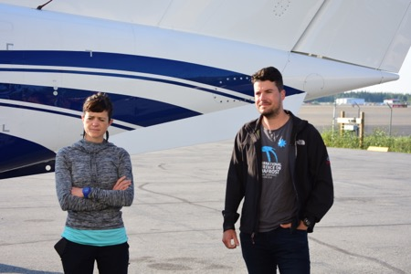
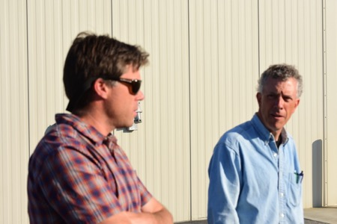
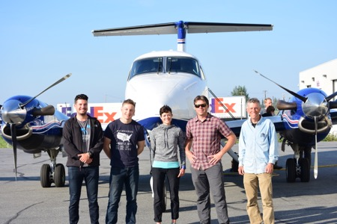
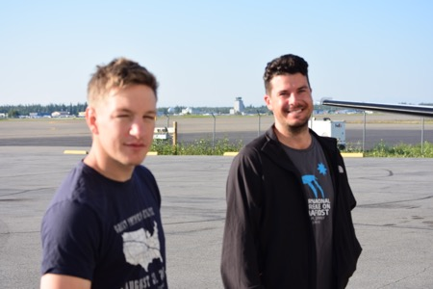
22 July 2017/DOY 202
Interior Alaska
Early morning visit from several field teams

Slide 5
22 July 2017/DOY 202
Interior Alaska
Member of the 40-mile Herd swimming the river
Notes:
40-mile herd featured in Sunday Daily News Miner article
http://www.newsminer.com/features/sundays/alaska_science_forum/parting-a-sea-of-fortymile-caribou
/article_6450bcf4-8b92-11e8-a192-3f5d81f497af.html

Slide 6
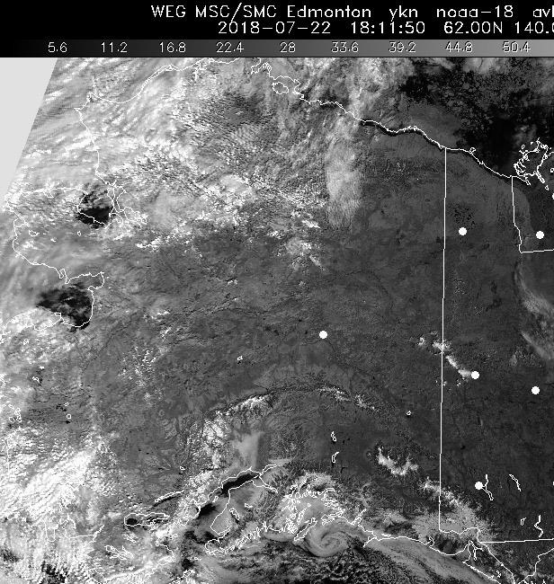
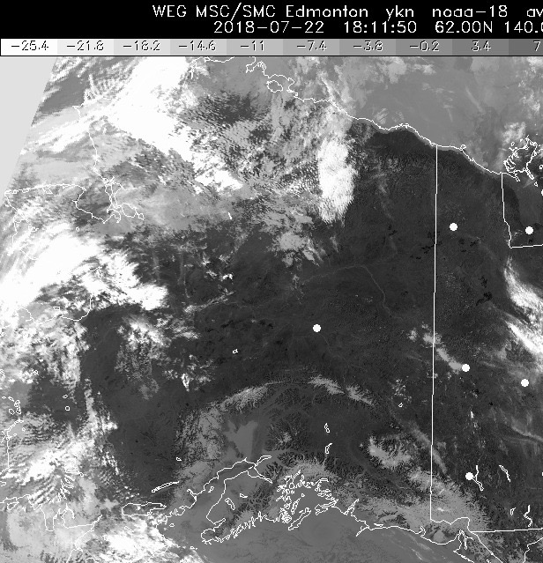
22 July 2017/DOY 202
Interior Alaska
HRPT Vis 1811Z
HRPT IR 1811Z
Visible (left) and IR (right) satellite imagery show the clear sky conditions observed across Interior Alaska from Fairbanks to the Canadian Border

Slide 7
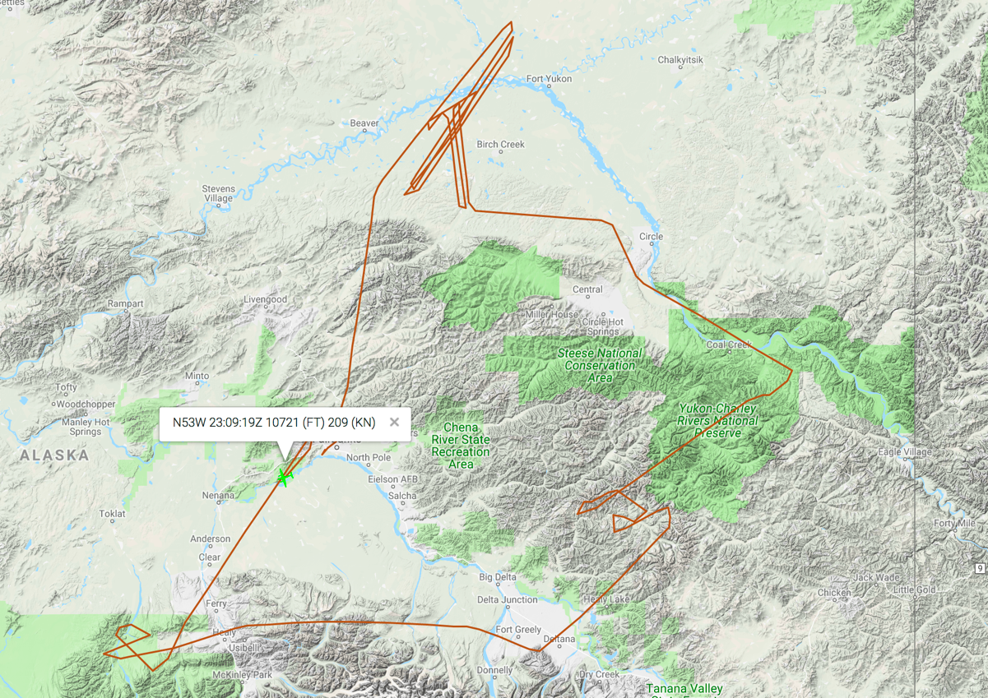
22 July 2017/DOY 202
Interior Alaska
As-flown Lines
Actual
Flight Lines

Slide 8
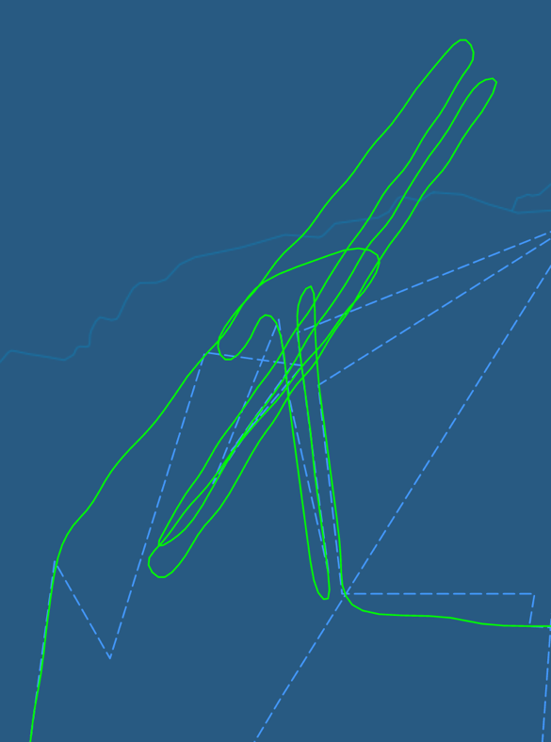
22 July 2017/DOY 202
Interior Alaska
Yukon Flats
As-flown Lines
Yukon Flats
Planned Lines

Slide 9
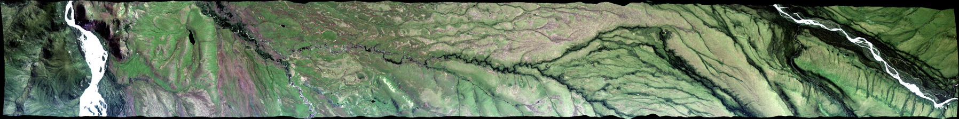
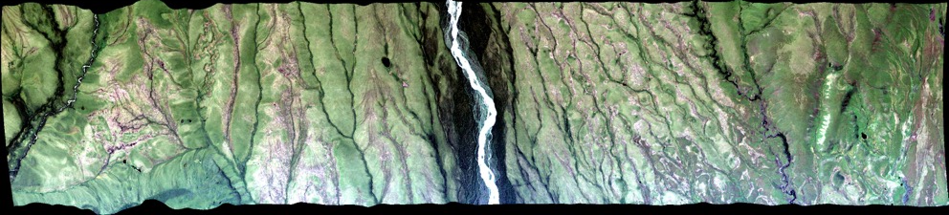
22 July 2017/DOY 202
Interior Alaska
AVIRIS-NG Quick-look products
https://avirisng.jpl.nasa.gov/cgi/flights.cgi?step=view_flightlog&flight_id=ang20180722t
A. Line 243A-Z, FL192, Run ID 180508: Healy
B. Line AVng_247A-Z, FL192, Run ID 181536: Healy
Winston Olson-Duvall, JPL
A
B
A. CH4 ebullition lakes at center of image
B. Smeared cloud at right hand edge

Slide 10
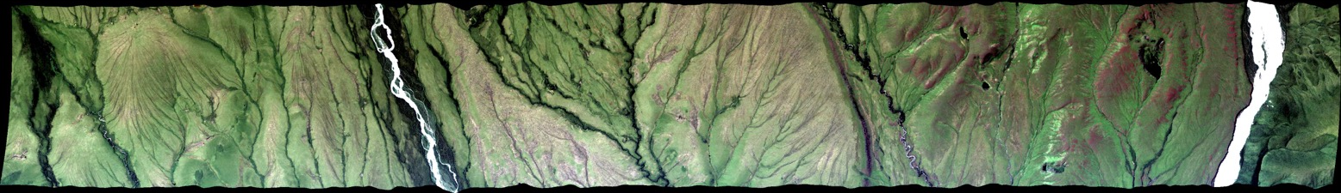
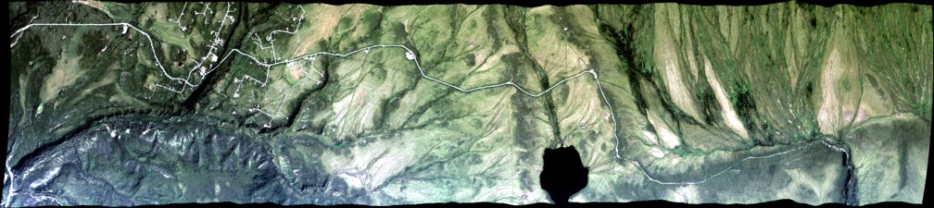
22 July 2017/DOY 202
Interior Alaska
AVIRIS-NG Quick-look products
https://avirisng.jpl.nasa.gov/cgi/flights.cgi?step=view_flightlog&flight_id=ang20180722t
A. Line AVng_246A-Z, FL192, Run ID 182214: Healy
B. Line AVng_242A-Z, FL194, Run ID 182956: Healy
Winston Olson-Duvall, JPL
A
B
A. CH4 ebullition lakes at center of image
B. Healy (left) and Eight-Mile Lake (center)

Slide 11
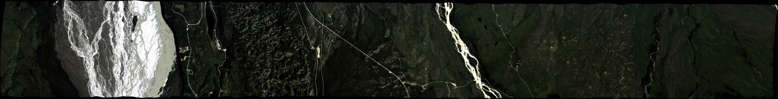
22 July 2017/DOY 202
Interior Alaska
AVIRIS-NG Quick-look products
https://avirisng.jpl.nasa.gov/cgi/flights.cgi?step=view_flightlog&flight_id=ang20180722t
A. Line AVng_256A-Z, FL191, Run ID 185317: Delta Junction
B. Line AB_T01_L004, FL185, Run ID 194510: Yukon Charlie, Forty-Mile Herd territory
Winston Olson-Duvall, JPL
A
B
A. Delta River, Delta Junction
B. Cloud interference

Slide 12
22 July 2017/DOY 202
Interior Alaska
AVIRIS-NG Quick-look products
https://avirisng.jpl.nasa.gov/cgi/flights.cgi?step=view_flightlog&flight_id=ang20180722t
A. Line AB_T01_L005, FL185, Run ID 200512: Yukon Charlie, Forty-Mile Herd territory
B. Line AB_B15_L003, FL180, Birch Creek 2, Run ID 203748: Yukon Flats
Winston Olson-Duvall, JPL
A
B
A. Yukon River running through Yukon Charlie
B. Yukon Flats wetlands
Notes:
B. #55 in Google Earth set

Slide 13
22 July 2017/DOY 202
Interior Alaska
AVIRIS-NG Quick-look products
https://avirisng.jpl.nasa.gov/cgi/flights.cgi?step=view_flightlog&flight_id=ang20180722t
A. Line AB_B15_L002, FL180, Birch Creek 2, Run ID 204801: Yukon Flats
B. Line AB_B15_L001, FL180, Birch Creek 2, Run ID 205755: Yukon Flats
Winston Olson-Duvall, JPL
A
B
A. Yukon Flats; Canvasback Lake at left edge
B. Yukon Flats wetlands
Notes:
A. #54 in Google Earth set
B. #55 in Google Earth set

Slide 14
22 July 2017/DOY 202
Interior Alaska
AVIRIS-NG Quick-look products
https://avirisng.jpl.nasa.gov/cgi/flights.cgi?step=view_flightlog&flight_id=ang20180722t
A. Line AVng_321B-Z, FL178, Run ID 210953: Yukon Flats
B. Line AB_B14_L004, FL179, Birch Creek 1, Run ID 212222: Yukon Flats
Winston Olson-Duvall, JPL
A
B
A. Yukon Flats; Canvasback Lake at left edge
B. Yukon Flats wetlands
Notes:
A. #70 in Google Earth set
B. #55 in Google Earth set

Slide 15
22 July 2017/DOY 202
Interior Alaska
AVIRIS-NG Quick-look products
https://avirisng.jpl.nasa.gov/cgi/flights.cgi?step=view_flightlog&flight_id=ang20180722t
A. Line AB_B14_L003, FL179, Birch Creek 1, Run ID 214026: Yukon Flats
B. Line AB_B14_L002, FL179, Birch Creek 1, Run ID 215812: Yukon Flats
Winston Olson-Duvall, JPL
A
B
A. Yukon Flats; Canvasback Lake at left edge
B. Yukon Flats wetlands
Notes:
A. #70 in Google Earth set
B. #55 in Google Earth set

Slide 16
22 July 2017/DOY 202
Interior Alaska
AVIRIS-NG Quick-look products
https://avirisng.jpl.nasa.gov/cgi/flights.cgi?step=view_flightlog&flight_id=ang20180722t
A. Line AVng_322A-B, FL179, Run ID 221648: Yukon Flats
B. Line AVng_321A-B, FL178, Run ID 223302: Yukon Flats
Winston Olson-Duvall, JPL
A
B
Quick Look in process
A. Cloud interference, especially at right edge
B. Yukon Flats wetlands
Notes:
A. #70 in Google Earth set
B. #55 in Google Earth set

Slide 17
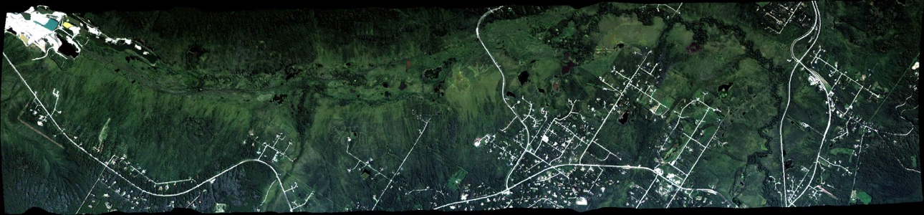
22 July 2017/DOY 202
Interior Alaska
AVIRIS-NG Quick-look products
https://avirisng.jpl.nasa.gov/cgi/flights.cgi?step=view_flightlog&flight_id=ang20180722t
A. Line AB_CH4_L001, FL183, Run ID 230037: Fairbanks
Winston Olson-Duvall, JPL
A
B
A. Big Trail Lake, Goldstream Lake, Donut Lake
Notes:
A. #86 in Google Earth set

Slide 18
Backup

Slide 19
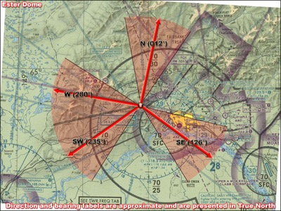
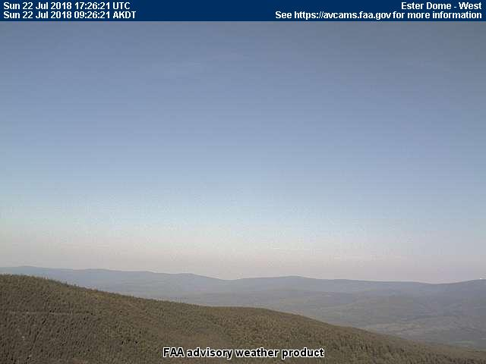
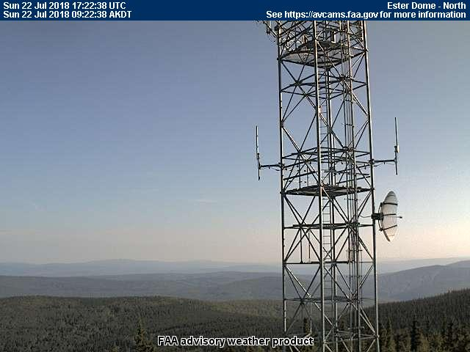
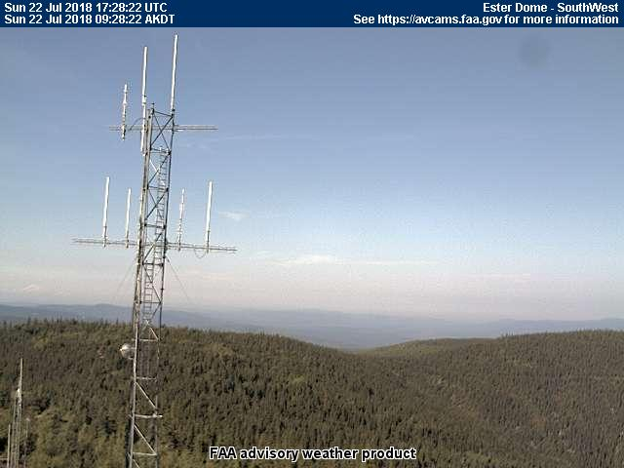
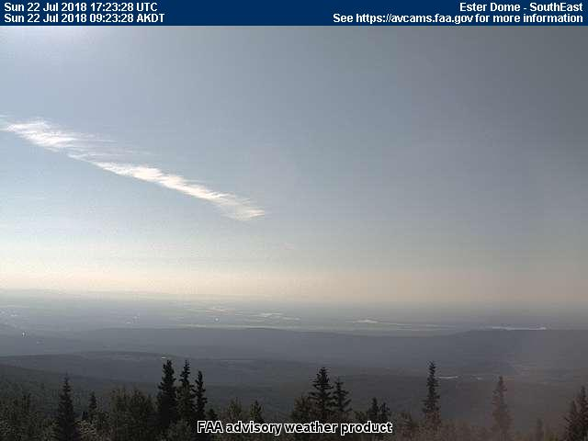
22 July 2017/DOY 202
Interior Alaska
Esther Dome
0926 AKDT/1726 UTC
Notes:
Images taken from the times when AVIRIS/N53W was acquiring data

Slide 20
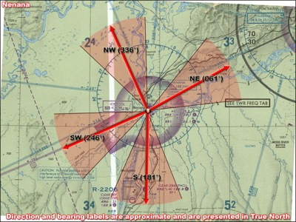
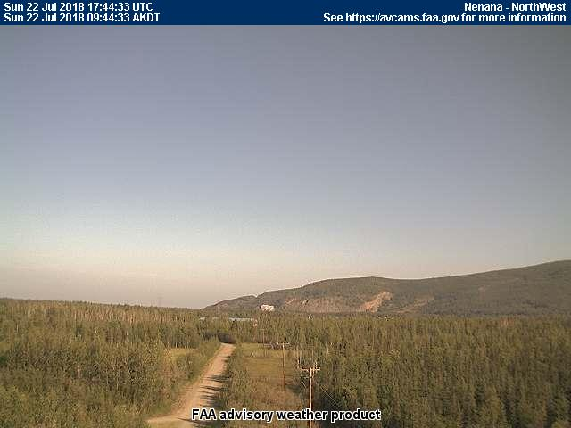
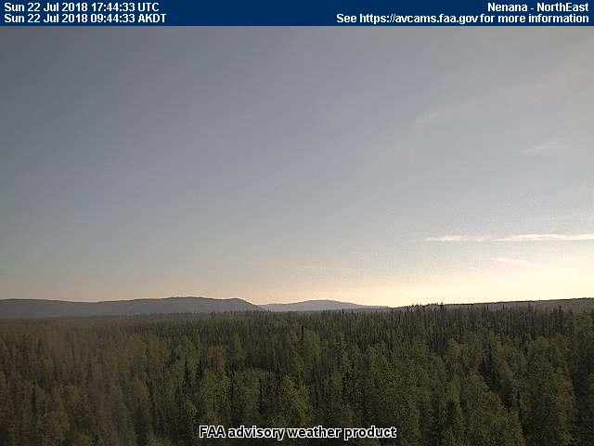
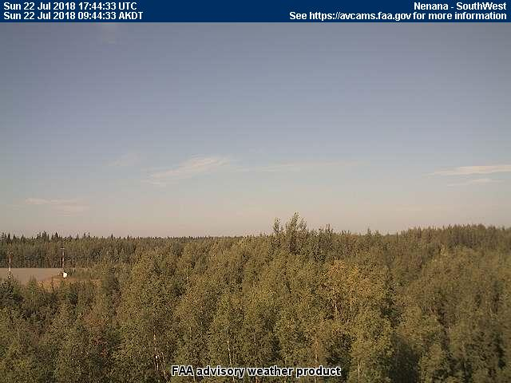
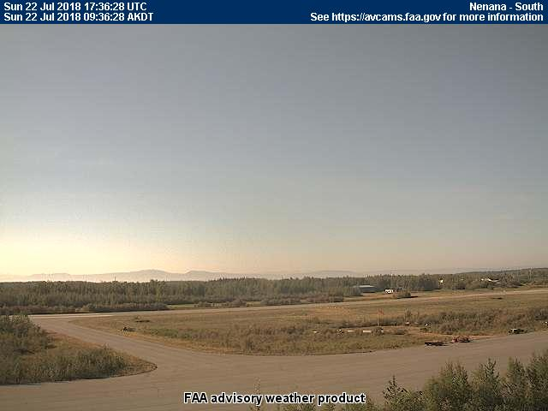
22 July 2017/DOY 202
Interior Alaska
Nenana
0944 AKDT/1744 UTC

Slide 21
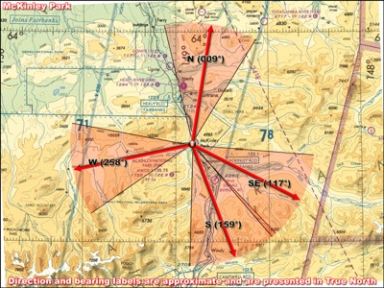
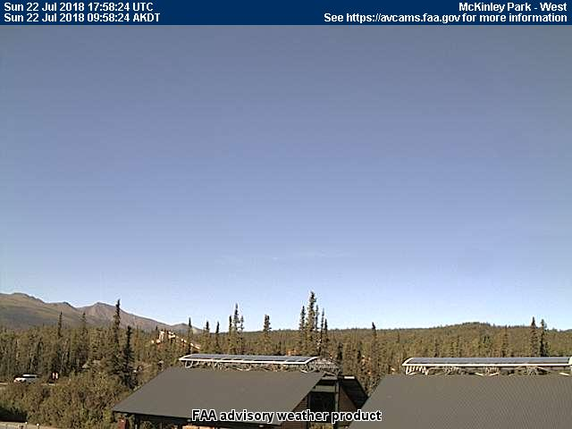
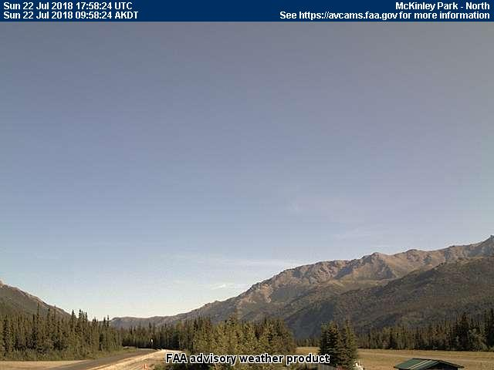
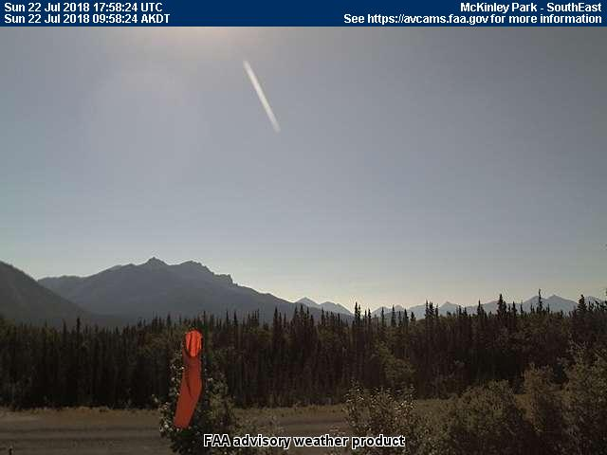
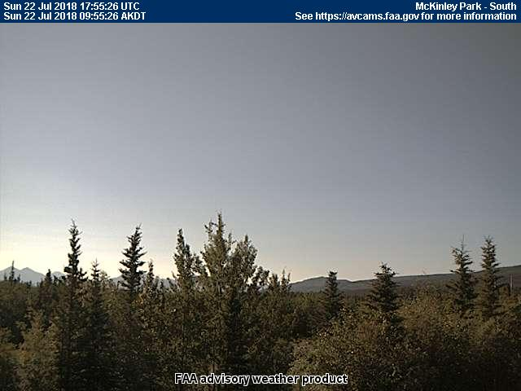
22 July 2017/DOY 202
Interior Alaska
McKinley Park
0958 AKDT/1758 UTC

Slide 22
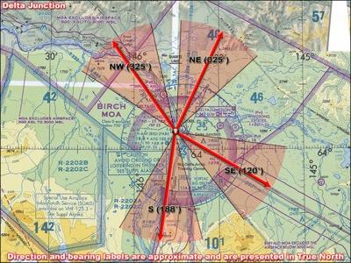
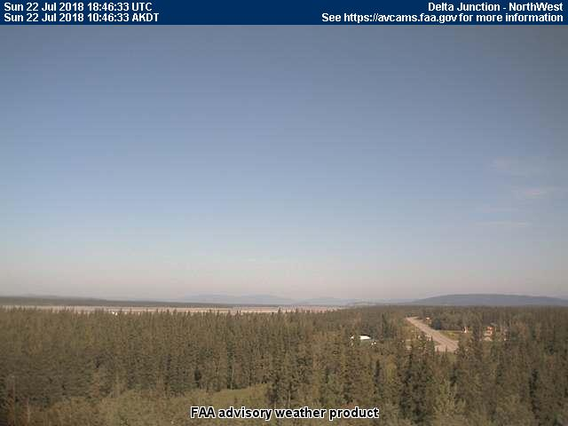
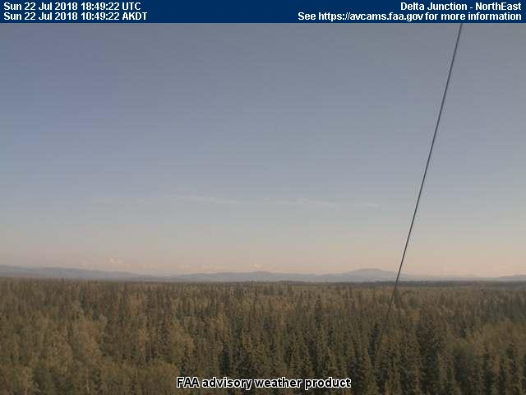
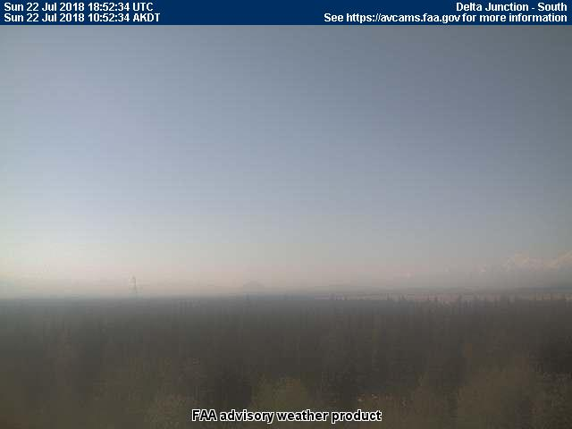
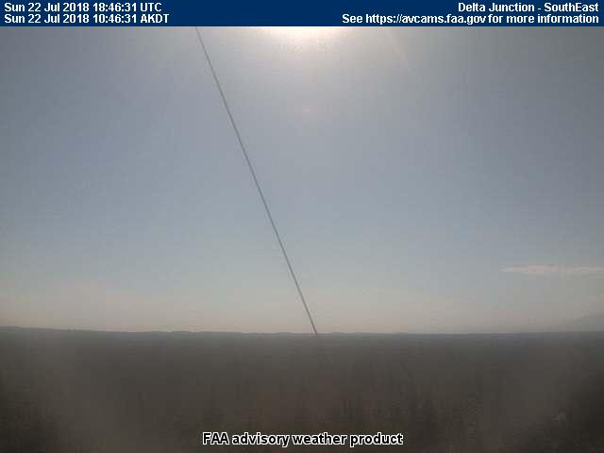
22 July 2017/DOY 202
Interior Alaska
Delta Junction
1052 AKDT/1852 UTC

Slide 23
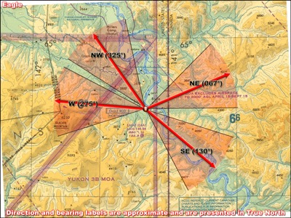
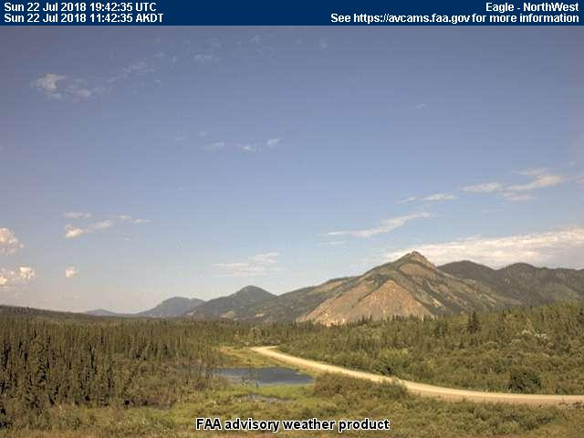
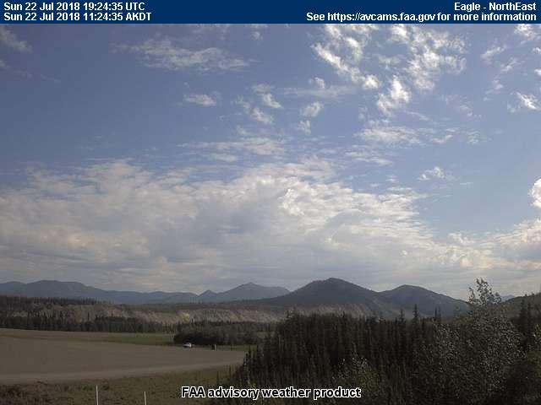
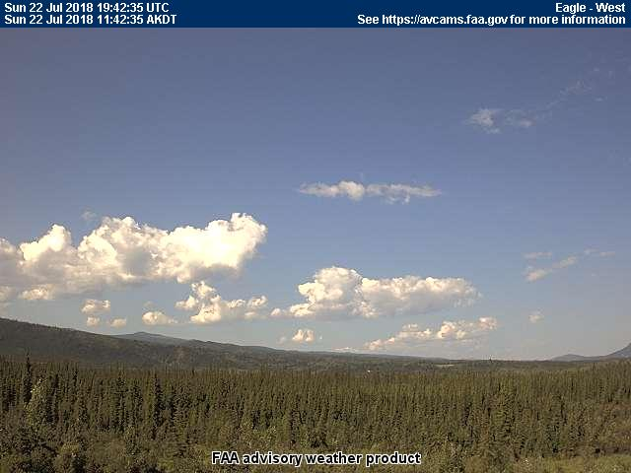
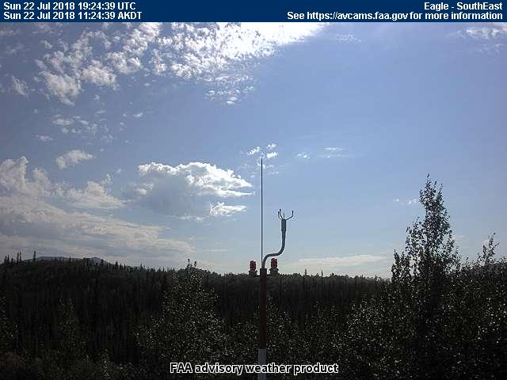
22 July 2017/DOY 202
Interior Alaska
Eagle
1142 AKDT/1942 UTC

Slide 24
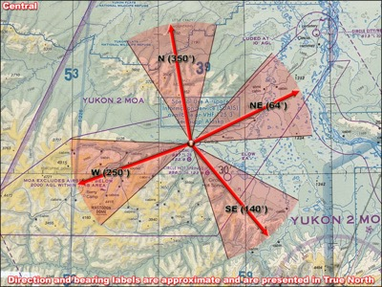
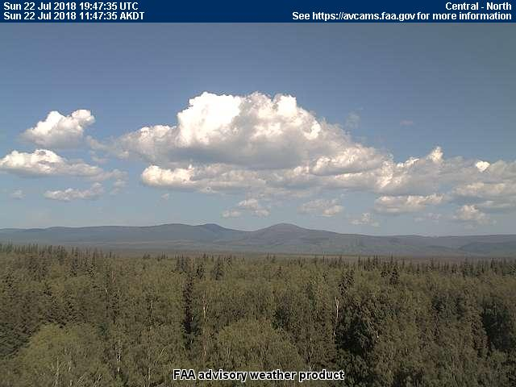
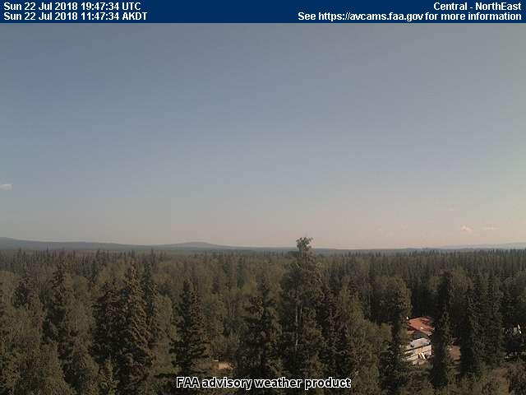
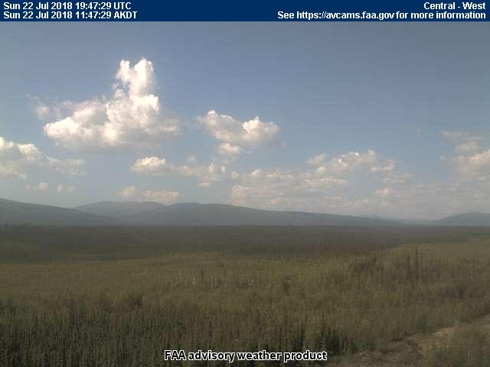
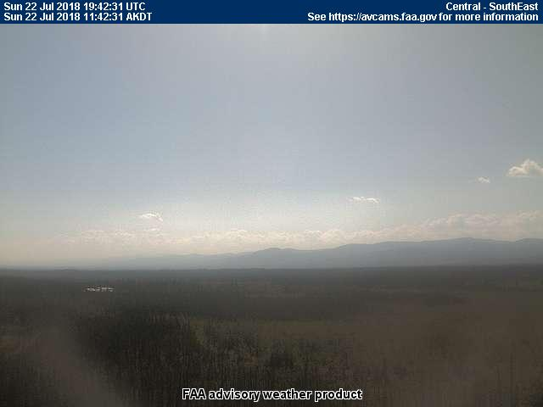
22 July 2017/DOY 202
Interior Alaska
Central
1147 AKDT/1947 UTC

Slide 25
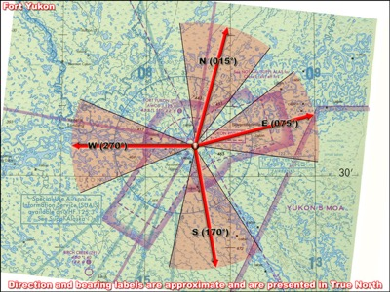
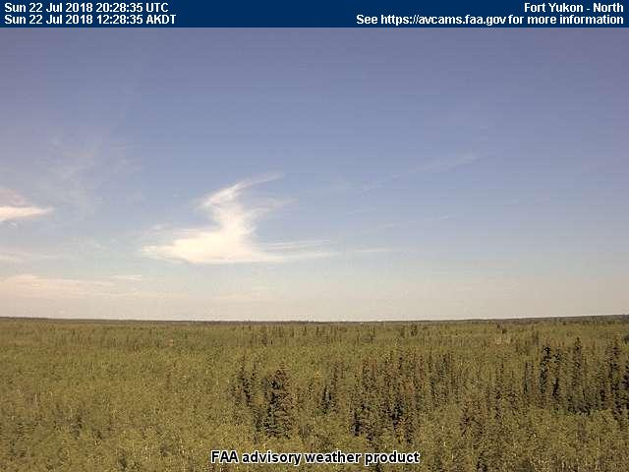
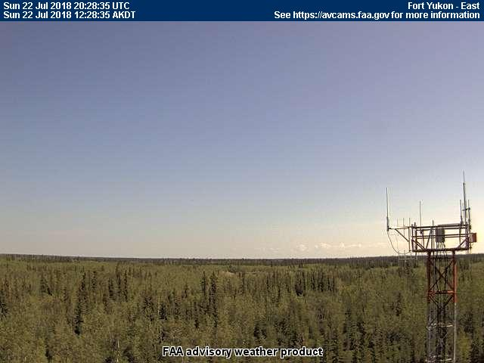


22 July 2017/DOY 202
Interior Alaska
Fort Yukon
1234 AKDT/2034 UTC

Slide 26




22 July 2017/DOY 202
Interior Alaska
Fort Yukon
1414 AKDT/2214 UTC

